Slide 1



The Model That Never Saw Your Data
Modern AI Tools for Air-Quality Time Series
Sarajevo summer school
7-9 September 2026
Emmanuel Karlo Nyarko
Faculty of Electrical Engineering, Computer Science and Information Technology Osijek

Slide 2
By the end of the hour, you'll be able to…
Explain a ‘foundation model’
and why it can forecast data it has never seen, no training needed.
Read a real forecast
of PM2.5, including the uncertainty (not just a single line).
1
2
Recognize two more tricks
smart gap-filling in time, and filling the map between stations.
Know what to try and trust
which tools are ready to use, and where to stay skeptical.
3
4
If you know what a pollution time series looks like, you're qualified for this.

Slide 3
Three words we'll use a lot
Time series
Measurements over time
(like your hourly PM2.5 readings)
Forecasting
Predicting what comes next
(the next hours or days)
A ‘model’
A recipe that turns the past (and weather) into a prediction.
1
2
3
That's the whole game:
use the measured past to predict the future.

Slide 4
Four everyday air-quality problems
Gaps
Holes in the data (sensor
downtime, calibration,…)
Between stations
What's the air like where
there's no monitor?
∅
▦
Forecasting
What happens in the next
day or two? (our main focus)
Did it work?
Was it the new policy — or
just a windy month?
↗
ƒ
Today: mostly forecasting, with quick looks at gaps and maps

Slide 5
How it's usually done
Pick one station and one pollutant
Fit a classic stats model (e.g. SARIMA)
Tune it and check it works
Sensor drifts or moves → redo it
Repeat for every station and pollutant
12 stations × 6 pollutants = a lot of models to build and babysit
It works, it's just a lot of hand-work
And you redo much of it whenever a sensor changes. Wouldn't it be nice if one ready-made model just handled any series?
SARIMA = a classic seasonal forecasting method from statistics.
Notes:
SARIMA stands for Seasonal Autoregressive Integrated Moving Average. It is used when data shows both:
Non‑seasonal structure (trend, short‑term autocorrelation)
Seasonal structure (patterns repeating every S periods, e.g., 12 months)
SARIMA is written as:
SARIMA (p, d, q) (P, D, Q)_S
Where:
p, d, q = non‑seasonal ARIMA terms
P, D, Q = seasonal AR, differencing, MA terms
S = length of seasonal cycle (e.g., 12 for monthly data with yearly seasonality)

Slide 6
Part 1
The big idea: a model that already learned
The same trick behind AI chatbots — reused for numbers instead of words.

Slide 7
Two ways to get a forecast
THE OLD WAY
THE NEW WAY
Learns from only your one series
Before it predicts? You fit and tune it
A new station? Start over
Sense of how data behaves? None. You bring it.
Learned from millions of series, everywhere
Before it predicts? Nothing, it’s ready
A new station? Just plug it in
Sense of how data behaves? Already learned
“Zero-shot” = it works on your data with no training. Just plug in and predict.
Notes:
electricity, weather, traffic, sensors,...

Slide 8
How does it work ? It reads your data like reading a sentence.
Your data
→
Read in chunks
→
Predict a range
the pollution history
spot the patterns
best guess + uncertainty
Reads in chunks
Learned once
Gives a range
Short windows of readings, like words in a sentence, so it catches the shape.
From millions of series of every kind. You just download it, ready to go.
Not a single line, a best guess plus how sure it is.
(The technical name is a ‘transformer’ , the same family behind chatbots. You don't need the details today.)

Slide 9
The toolbox in 2026 (These run on a normal laptop)
MODEL | RUNS ON A LAPTOP? | WHAT IT’S GOOD FOR
Chronos-Bolt (Amazon) | Yes, fast even on a CPU | Quick forecasts, a strong baseline
Chronos-2 | Yes | Forecasts that also use weather
TimesFM (Google) | Yes | General purpose forecasts
Granite TTM (IBM) | Yes, tiny | A quick sanity check
600M+
laptop
no supercomputer needed
training on your data
downloads (people trust these)
0
Notes:
Chronos (Amazon, 2024): Encoder-decoder T5 architecture with value tokenization. Produces probabilistic forecasts. Pretrained on a mix of public datasets and synthetic Gaussian process data. Released openly on Hugging Face in sizes ranging from 20M to 710M parameters.
Chronos-Bolt is a family of pretrained time series forecasting models which can be used for zero-shot forecasting. It is based on the T5 encoder-decoder architecture and has been trained on nearly 100 billion time series observations.
Chronos-2 is a 120M-parameter, encoder-only time series foundation model for zero-shot forecasting. It supports univariate, multivariate, and covariate-informed tasks within a single architecture.
- external signals are called covariates (also known as exogenous regressors or external features)
TimesFM (Google, 2024): Decoder-only transformer pretrained on roughly 100 billion real-world time points sourced from Google Trends, Wikipedia pageviews, and synthetic augmentation. Uses input and output patching to handle variable-length horizons efficiently
Granite Tiny Time Mixer (TTM) (IBM 2025)
TSFM – Time Series Foundation Models
Sources electricity, weather, traffic, sensors

Slide 10
Part 2
Let’s forecast some data

Slide 11
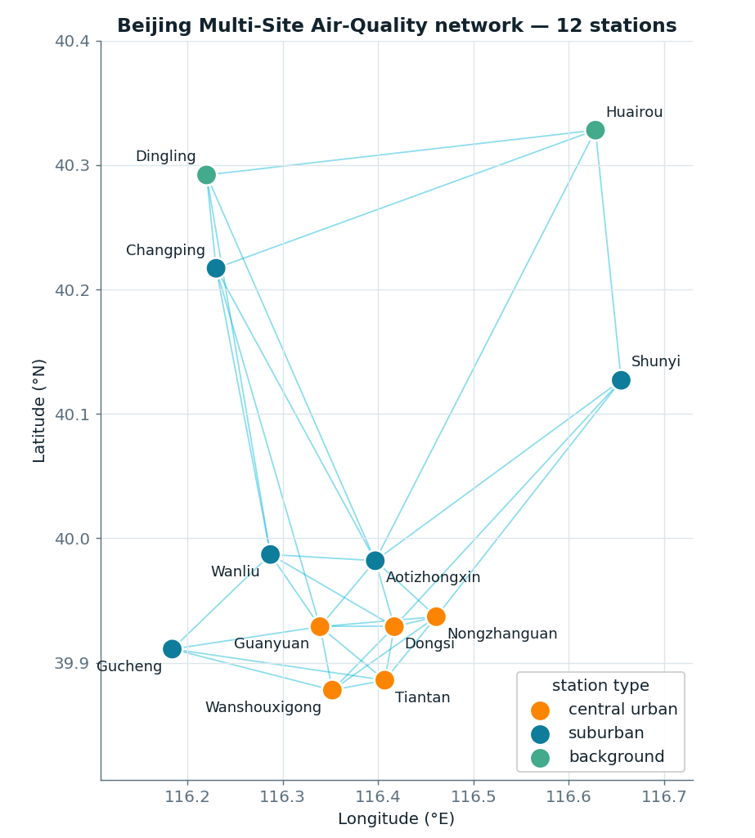
Beijing Multi-Site Air Quality
12 monitoring stations across the city
4 yrs every hour, 2013–2017
6 pollutants: PM2.5, PM10, SO₂, NO₂, CO, O₃
+ weather: temp, pressure, wind, rain…
https://archive.ics.uci.edu/static/public/501/beijing+multi+site+air+quality+data.zip

Slide 12
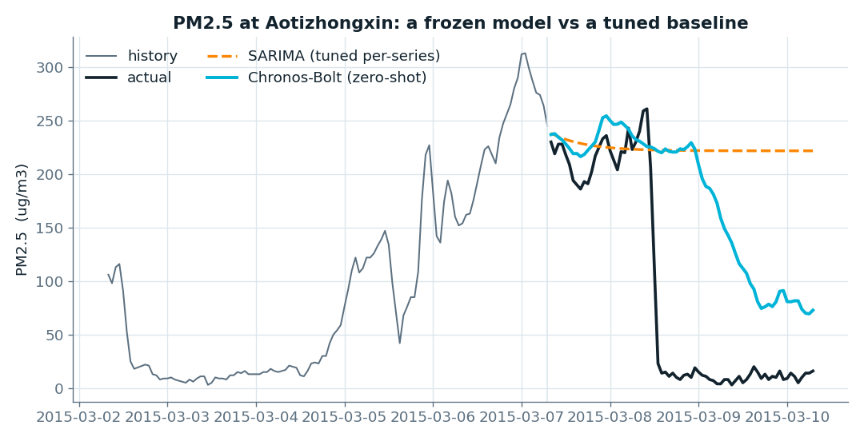
Demo 1: Forecast with no training
512 hrs history
72 hrs horizon
Chronos-Bolt (zero-shot) vs tuned SARIMA

Slide 13
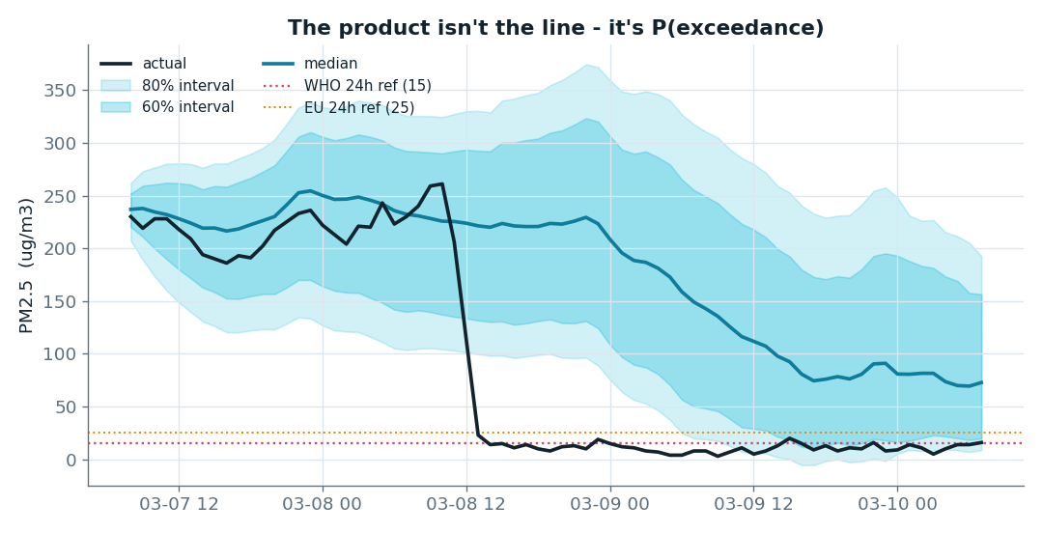
Demo 2: A range, not just a line
The forecast (Chronos-Bolt) as a shaded range, with health-guideline lines drawn on

Slide 14
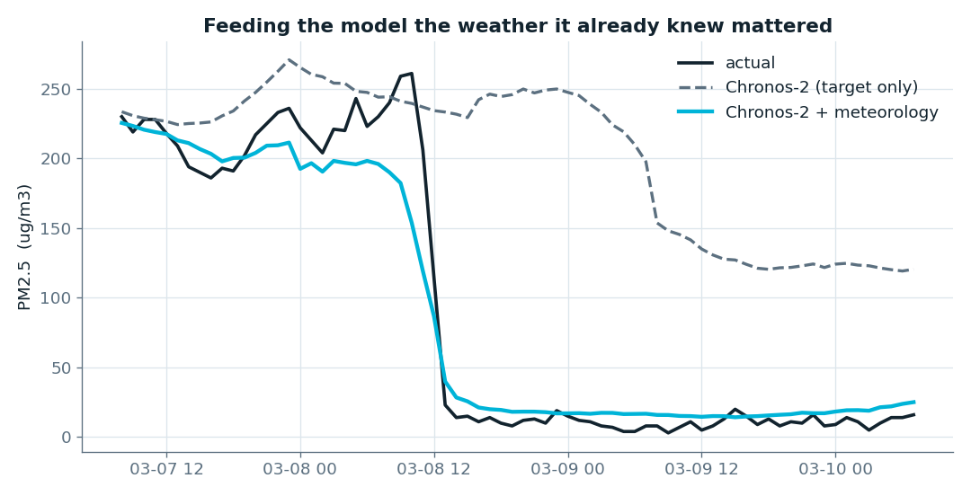
Demo 3: Now give it the weather
Chronos-2 with and without covariates(temperature. wind, pressure)
MAE: Chronos-2 (no cov)=109.92 (with cov)=14.87

Slide 15
Where it still struggles
Big spikes
Rare pollution episodes are uncommon in its training, so it can under-shoot them.
Bad weather input
A wrong weather forecast going in means a weaker pollution forecast coming out.
1
2
Far ahead
The further out you predict, the shakier it gets. It is not a crystal ball.
Sometimes local wins
With lots of clean history for one steady station, a hand-built model can still edge ahead.
3
4
The habit to keep: always compare against a simple baseline, and don't blindly trust one line.

Slide 16
Bonus #1
Filling the gaps

Slide 17
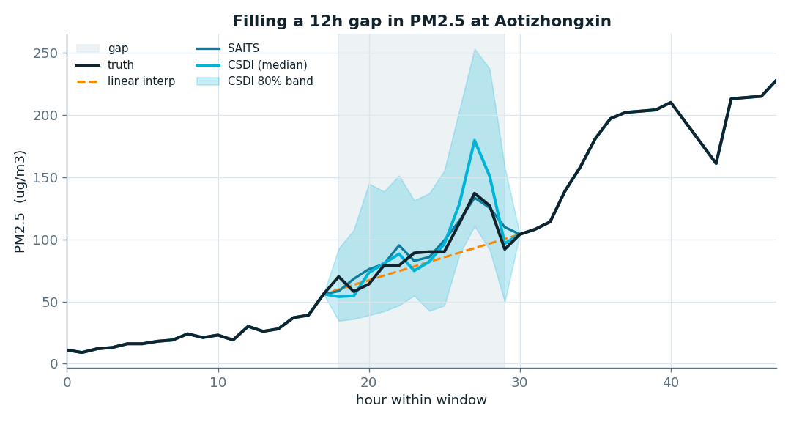
Smart gap-filling
48 hrs window
12 hrs gap
SAITS - Self-Attention-based Imputation for Time Series
CSDI - Conditional Score-Based Diffusion Models

Slide 18
Bonus #2
Filling the map
Notes:
Between your stations, you're guessing. A ‘network’ model guesses better than ‘nearest wins’.

Slide 19
Your stations are a network
‘NEAREST WINS’
The classic map fill: closer stations count more. Simple, but blind to roads, hills and wind.
NETWORK MODEL
Learns how stations really relate. A neighbor can matter more than a closer station that's different.
hidden
Guess the „orange” station from its neighbours + the weather.

Slide 20
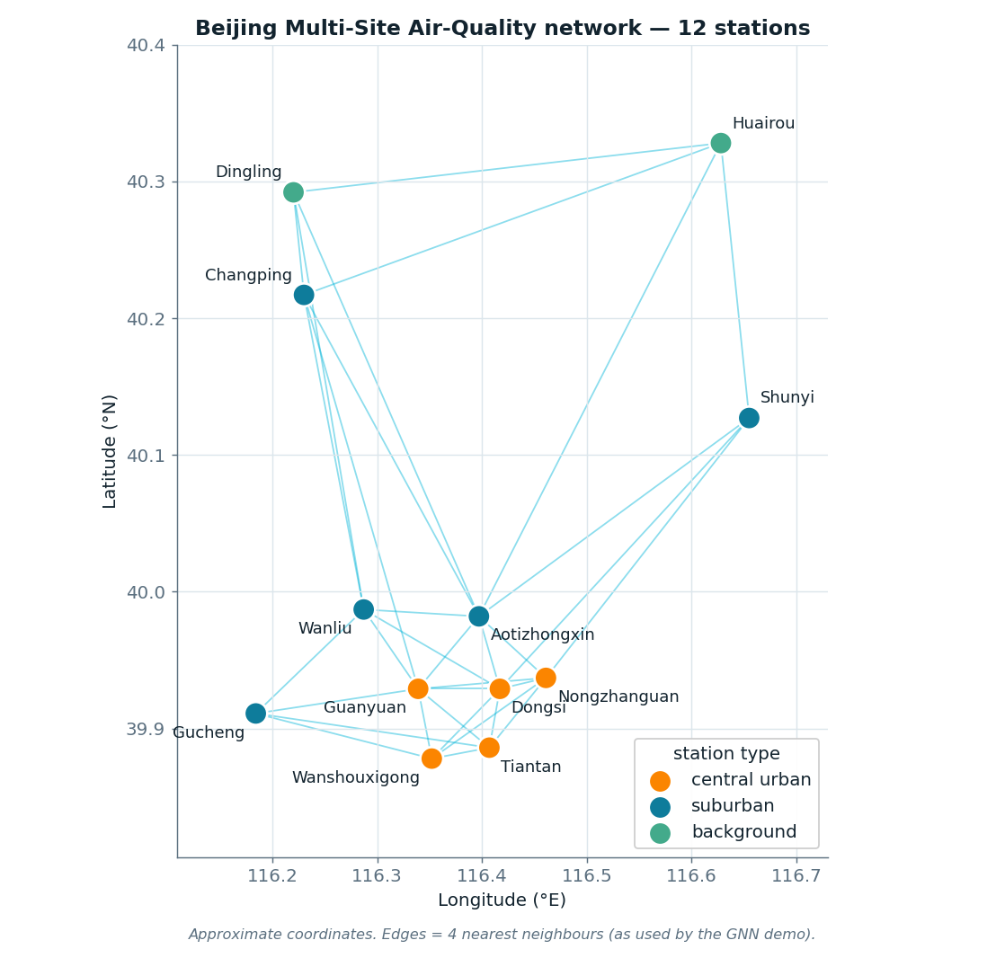

Guess a hidden station
Inverse Distance Weighting (IDW) :
A classic, pre-machine-learning way to estimate a value
at a place where you have no measurement, using the
measurements you do have nearby.
You take an average of the neighbours, but a weighted
one, where closer stations count more

Slide 21
Guess a hidden station
Graph Neural Network (GNN) :
The model is trained node-agnostically
(mask a RANDOM node each step), so
ONE trained model reconstructs ANY station.
This way the model never gets to memorize one station.
To keep doing well across all of them, it's forced to learn
the general rule of spatial interpolation rather than a
station-specific shortcut
Notes:
The setup. You have 12 monitoring stations. The task is: hide one station's readings and predict them from the other 11 (plus the weather). "Node" is just the graph word for a station — in a graph, the things are nodes and the connections between them are edges, and your station network is a graph.
What "node-agnostic" means. "Agnostic" here means "doesn't care which one." So a node-agnostic model is one that isn't tied to a specific station. It hasn't learned "how to reconstruct Huairou" — it has learned the general skill of "reconstruct whichever station is missing, from its neighbours and the weather." Point it at any hidden station and it does its thing.

Slide 22
Guess a hidden station
station | isol. (avg. km) | IDW (MAE) | GNN+IDW (MAE) | win
Huairou | 34.1 | 21.87 | 21.17 | *
Dingling | 28.8 | 21.03 | 20.36 | *
Shunyi | 26.6 | 19.45 | 19.23 | *
Changping | 24.4 | 18.02 | 17.68 | *
Gucheng | 14.9 | 17.12 | 17.49
Wanliu | 10.6 | 11.25 | 10.97 | *
Aotizhongxin | 7.7 | 9.71 | 9.55 | *
Wanshouxigong | 7.5 | 11.46 | 11.86
Nongzhanguan | 7.3 | 10.57 | 10.66
Guanyuan | 6.9 | 10.02 | 10.46
Tiantan | 6.1 | 10.29 | 10.18 | *
Dongsi | 5.4 | 10.6 | 11.32
hide one station; classic estimate vs classic + a learned correction

Slide 23
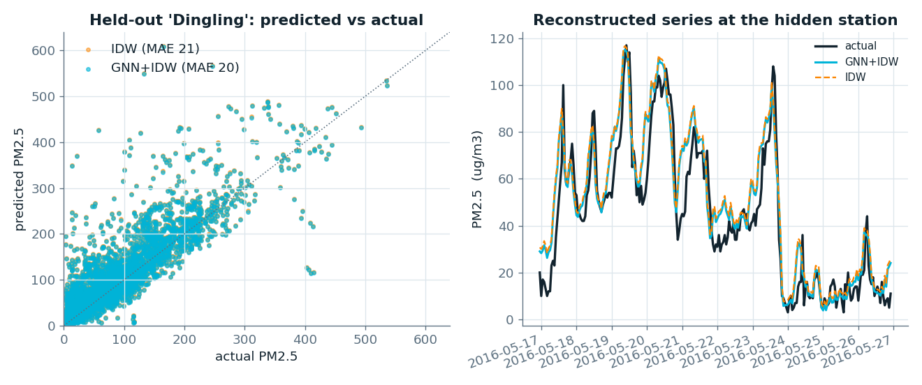
Guess a hidden station

Slide 24
The whole hour ....
Forecast
a ready-made model predicts your series, no training
Fill Gaps
smart gap-filling that shows its doubt
Fill the map
a network model guesses between stations
∅
▦
↗
Forecasting is plug-and-play (pretrained). Gaps and maps you train, but on modest data, in minutes, on a laptop.

Slide 25
The Take Away
You can get a strong forecast on day one, no years of stats first…?!
These tools do the heavy lifting. What makes a forecast trustworthy is still you… your knowledge of the chemistry, the sensors, and when a number looks wrong. That judgement is the valuable part.

Slide 26
THANK YOU
Questions?
Try it: Free models: chronos, pypots,…
Data: Beijing Multi-Site Air Quality (UCI, free)
karlo.nyark@ferit.hr

